Slide 1

E-COMMERCE SALES ANALYTICS DASHBOARD
KLH UNIVERSITY
(Insert official logo)
A FLEXIBLE DATA SCIENCE PLATFORM FOR SALES EXPLORATION AND CUSTOMER SEGMENTATION
Final Project Review | Department of Computer Science and Engineering | KLH University – CSE, Bowrampet Campus
TEAM MEMBERS
P. Roshan – 2420030701
Om Pandey – 2420030791
P.V.V. Satya Sai – 2420030704
Vadde Tharun Kumar – 2420039804
Guide: B. Prathusha Assistant proffesor Academic Year: 2026–27
Notes:
Title slide. Replace all bracketed text. Use the full project title, list every team member with registration number, and name your guide. Insert the institution logo in the dashed box.

Slide 2



Introduction & Problem Statement
Background
Raw CSV / Excel files → cleaning and analysis → interactive sales dashboard
E-commerce platforms generate transaction data across orders, products, customers, dates and regions. Analysing these records helps businesses understand what sells, when demand changes and which customers contribute most value.
Problem Statement
Sales data is often stored in different CSV/Excel formats, with inconsistent column names and data-quality issues. Without a reusable analysis workflow, teams must repeatedly clean data and build reports manually.
Motivation / Need
Retail analysts, small businesses and students need a practical way to turn raw transaction files into reliable sales insights. Delayed or inconsistent reporting can hide weak products, changing demand and valuable customer groups.
Notes:
State the domain, the exact problem and why it matters. Keep it to about 2 minutes. Add one real-world statistic if you can, with a citation.

Slide 3


Objectives & Scope
Objectives
1
Build a Streamlit dashboard that accepts CSV and Excel transaction datasets.
2
Create a reusable preprocessing pipeline with column mapping, type conversion and data-quality checks.
3
Explore revenue, orders, products, regions and time-based sales patterns through interactive visualisations.
4
Generate RFM customer features and apply K-Means clustering when customer and transaction fields are available.
Scope: descriptive and customer analytics for transaction datasets; predictive demand forecasting, payment and
live e-commerce integration are outside the current scope.
Notes:
Objectives should be measurable and start with action verbs. The scope slide tells the panel what you did and did not attempt.

Slide 4
Literature Survey
S.No | Author(s) & Year | Method / Technique | Key Findings | Limitation / Gap
1 | MacQueen (1967) | K-Means clustering | Introduced an iterative partitioning method for grouping observations by similarity. | Requires numeric features and a chosen number of clusters; results depend on scaling and initialisation.
2 | Rousseeuw (1987) | Silhouette analysis | Proposed a measure to assess cohesion and separation of clusters. | A score evaluates cluster structure, not business usefulness on its own.
3 | Hughes (1994) | RFM customer analysis | Describes using recency, frequency and monetary value for customer-focused marketing. | RFM scores depend on the chosen observation window and business context.
4 | Chen et al. (2012) / UCI | Online Retail transaction dataset | Provides real-world UK online retail transactions for data mining and analysis. | One dataset has a fixed domain and schema; reusable tools need to handle varied user datasets.
Research Gap
Research gap: many examples analyse one fixed dataset and assume fixed column names. This project combines user-defined CSV/Excel input, configurable field mapping, reusable cleaning and optional RFM/K-Means analysis in one dashboard.
Notes:
Summarise four to six relevant papers or existing systems. End with the research gap, because that gap justifies your project.

Slide 5





Proposed System & Methodology
STEP 1
STEP 2
STEP 3
STEP 4
STEP 5
Define Problem
Collect Data
Design
Implement
Test & Evaluate
Support repeatable analysis of transaction datasets with varied schemas.
Upload CSV/XLSX; use UCI Online Retail as a reference dataset or any compatible user dataset.
Python, Pandas, Plotly, Streamlit; RFM features and K-Means clustering.
Dataset upload, column mapping, cleaning, KPI calculation, charts and customer segmentation.
Validate required fields, missing values, calculations, upload formats and cluster quality (silhouette score).
Key Novelty / Contribution
Contribution: a dataset-flexible dashboard that separates schema mapping from analysis, so users can reuse the same workflow across different retail transaction files. Customer segmentation is enabled only when the required fields exist.
Notes:
Walk through the five steps left to right. Rename the steps to match your project (for example, Requirement Analysis, Design, Coding, Testing, Deployment). End with your novelty.

Slide 6
System Architecture
Components
CSV / XLSX
Upload
Column
Mapping
Cleaning &
Transformation
EDA + RFM /
K-Means
Interactive
Dashboard
1. Data Input
Upload CSV / Excel or select reference dataset
1
2
2. Schema Mapping
Upload CSV / Excel or select reference dataset
3
3. Analytics Engine
Upload CSV / Excel or select reference dataset
4
4. Dashboard & Export
Upload CSV / Excel or select reference dataset
Notes:
Insert a clear block diagram: input, processing, storage, output. Number each block and explain them on the right. Redraw the figure yourself rather than copying it.

Slide 7


Hardware & Software Requirements
Hardware
Software & Tools
Libraries / Frameworks
Windows 10/11; standard Intel/AMD laptop; 8 GB RAM recommended.
Approx. 500 MB for application environment; dataset size varies.
Not required (software-only project).
Internet required for initial package installation / optional dataset download.
Windows 10/11
Python 3.11+
Command Prompt / VS Code (optional)
Git / GitHub (optional)
Pandas, NumPy
Scikit-learn, Plotly
Streamlit; OpenPyXL for Excel
No database required; local file-based workflow
Deployment / Platform: Local Windows machine; Streamlit serves the dashboard at localhost:8501
Notes:
List only what you actually used, with versions. For a pure software project, shorten the hardware list and add cloud or deployment resources.

Slide 8
Dataset / Data Understanding
Dataset profile is generated after upload: row count, column count, missing values, sample rows and detected field mappings.
Variable
Variable
Records (rows)
Features (columns)
Measured
N/A
Missing values
Target classes
Source: User-uploaded CSV/XLSX; UCI Online Retail is the reference dataset.
Fields: date, order ID, product, customer, quantity, unit price/revenue and region (depending on file).
Quality checks: missing fields, invalid dates/numbers, duplicate rows and non-positive quantities/prices are reviewed.
Notes:
Explain where the data came from and what it contains. Show a screenshot of the first rows or the info summary. For non-data projects, replace this slide with “Requirement Analysis” or “Input Specification”.

Slide 9



Data Preprocessing & Exploratory Analysis
Cleaning
Transformation
Feature Selection
Standardise column names; parse dates and numeric fields; remove exact duplicates; flag invalid quantities/prices. Missing optional fields remain unavailable rather than fabricated.
Use available business fields for analysis. RFM uses Recency, Frequency and Monetary features when customer ID, date and order/revenue fields are present.
Convert date, quantity and price to suitable types. StandardScaler is applied to RFM features before K-Means.
Notes:
Show two or three plots that tell a story: distributions, correlations, outliers. Explain what each plot told you and what you did about it.

Slide 10
Module-wise Description
1
Dataset Ingestion
2
Column Mapping
Purpose: Reads CSV/XLSX and previews rows.
Input → Output: File → DataFrame
Developed by: P. Roshan / team
Purpose: Connects source headers to standard fields.
Input → Output: Headers → mapped schema
Developed by: P. Roshan / team
3
Preprocessing & EDA
4
Customer Segmentation
Purpose: Cleans data and calculates KPIs/trends.
Input → Output: Raw rows → clean dataset + charts
Developed by: P. Roshan / team
Purpose: Builds RFM and K-Means groups when possible.
Input → Output: Customer transactions → segments
Developed by: P. Roshan / team
Notes:
Divide the project into three to five modules. For each, state its purpose, inputs, outputs and who built it. Duplicate a card if you have more modules.

Slide 11

Algorithms & Technologies Used
Exploratory Data Analysis
RFM Analysis
K-Means Clustering
Why chosen
Summarises sales patterns, distributions and category performance without requiring a target label.
Key parameters
KPIs, group-by aggregation, time-based resampling and interactive Plotly charts.
Why chosen
Summarises sales patterns, distributions and category performance without requiring a target label.
Key parameters
KPIs, group-by aggregation, time-based resampling and interactive Plotly charts.
Why chosen
Summarises sales patterns, distributions and category performance without requiring a target label.
Key parameters
KPIs, group-by aggregation, time-based resampling and interactive Plotly charts.
Selection criteria: Choose K-Means only when customer-level RFM features are available; scale features and compare candidate cluster counts using silhouette score and interpretability.
Notes:
Name each model, algorithm or technology, say why you chose it, and list the key settings. Then explain how you picked the final one.

Slide 12
Implementation / Model Building
Feature Selection
Code snippet / pseudocode
Date, order, customer, product, quantity, unit price/revenue and region are mapped when present.
# Example processing logic
sales['Revenue'] = sales['Quantity'] * sales['UnitPrice']
rfm = build_rfm(sales)
X = StandardScaler().fit_transform(rfm)
labels = KMeans(n_clusters=k, random_state=42).fit_predict(X)
Preprocessing Pipeline
Read file → standardise headers → map fields → parse types → validate → remove duplicates → calculate derived revenue/RFM.
Data Splitting
Not applicable to descriptive analytics. K-Means is unsupervised and uses available customer records.
Configuration
Numeric RFM features are scaled; candidate cluster counts are evaluated with silhouette score; fixed random_state supports repeatability.
Notes:
Describe the build in the order you did it. Paste only the most important code or pseudocode, not entire files. For hardware projects, show the circuit or wiring summary instead.

Slide 13
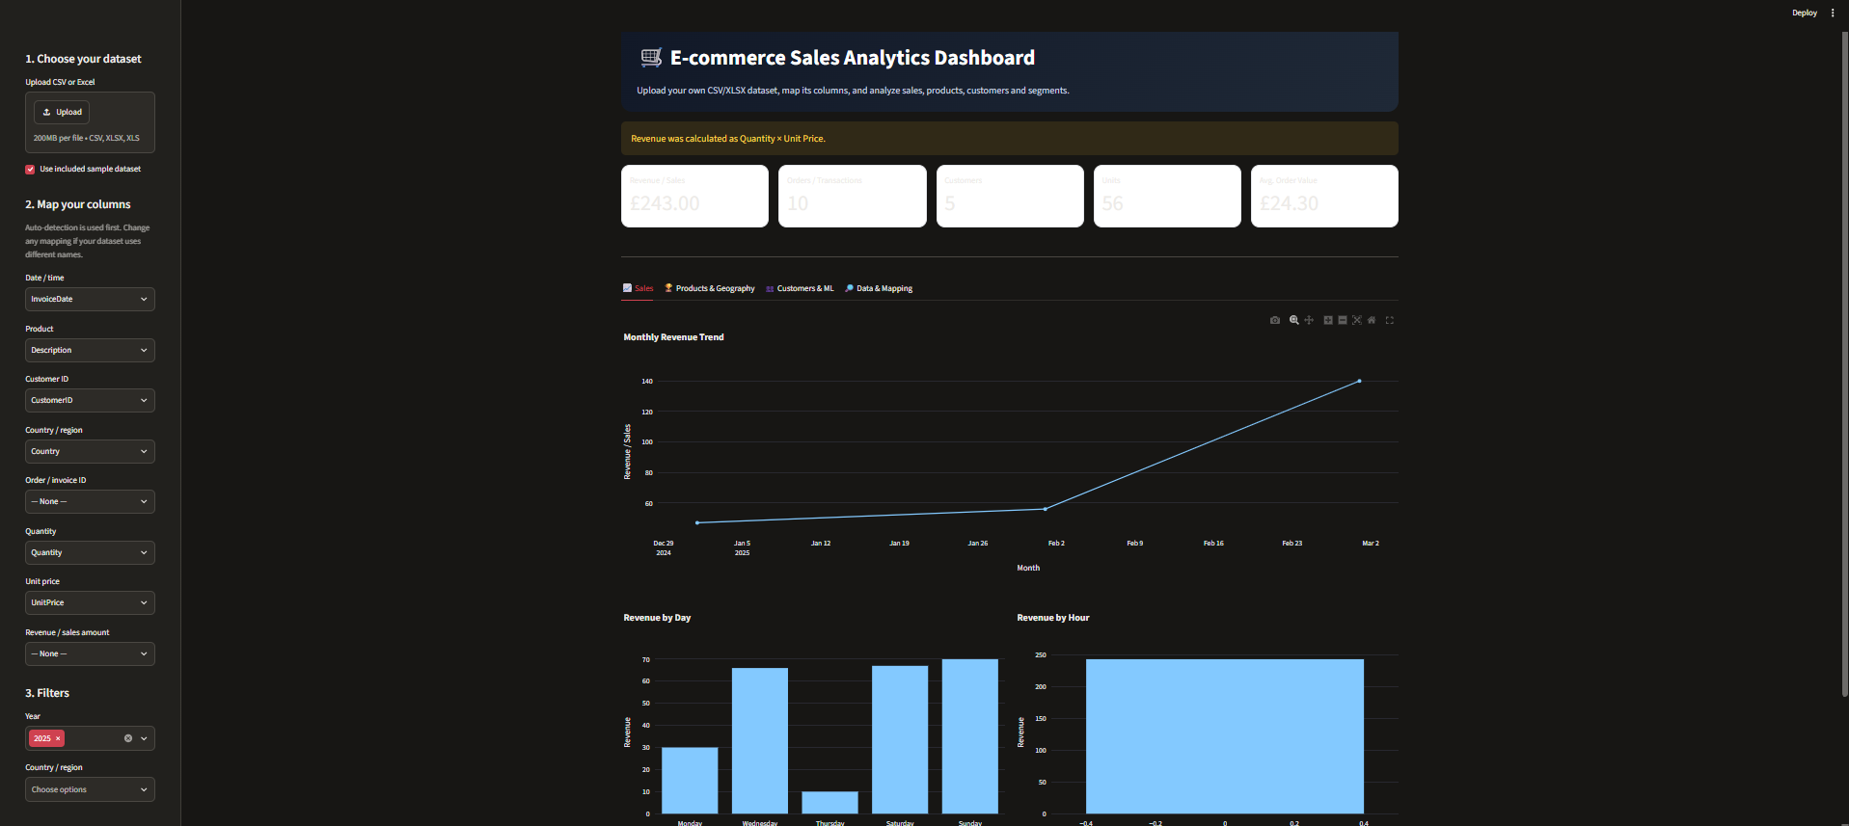
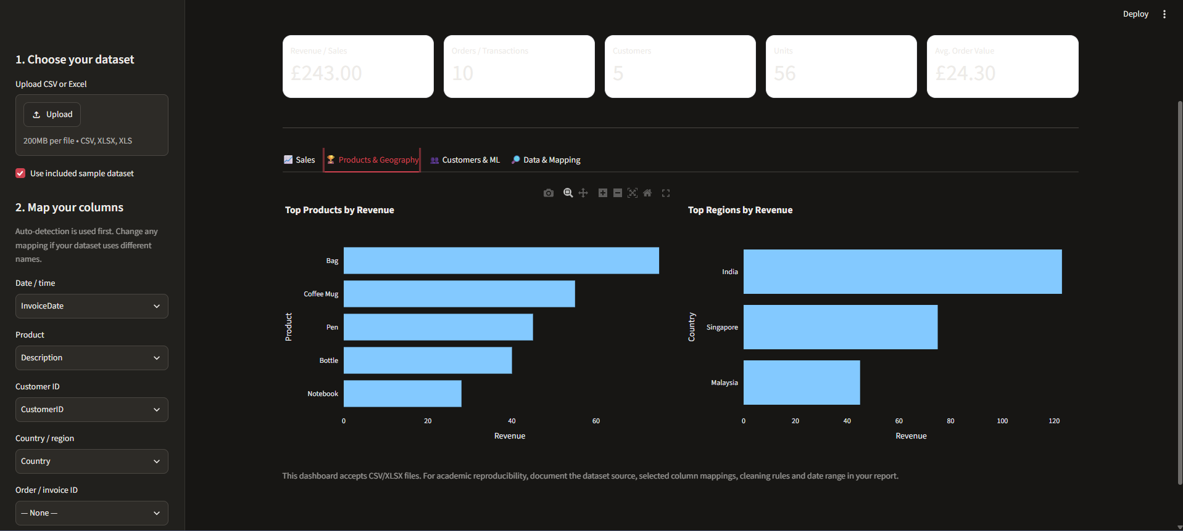
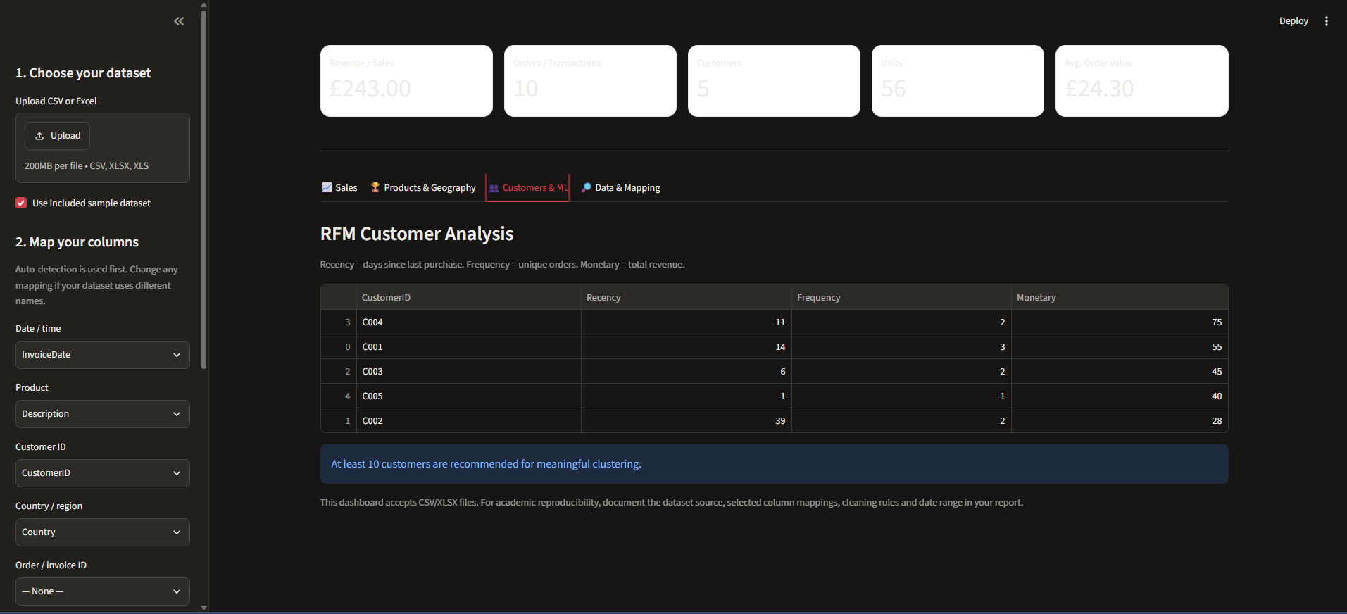
Working Prototype / Output Screens
Customer segments
(Insert live app screenshot)
Sales KPI overview
Revenue, orders, customers and units after a dataset is loaded.
Time and product analysis
Revenue, orders, customers and units after a dataset is loaded.
RFM + K-Means
Revenue, orders, customers and units after a dataset is loaded.
Notes:
Show real screenshots, photos of the hardware or a short demo video link. Caption each one with what the viewer should notice.

Slide 14
Results & Performance Comparison
Metric | Model A | Model B | Model C
Accuracy | 0.00 | 0.00 | 0.00
Precision | 0.00 | 0.00 | 0.00
Recall | 0.00 | 0.00 | 0.00
F1-score | 0.00 | 0.00 | 0.00
ROC-AUC | 0.00 | 0.00 | 0.00
Evaluation: dataset-dependent; metrics are calculated when a file is uploaded.
No fixed performance numbers are claimed. Report actual row counts, KPI values and silhouette score from the selected dataset.
Notes:
Right-click the chart and choose Edit Data to enter your real numbers. Replace the metrics with the ones that fit your project (accuracy, latency, power, throughput, user rating). State clearly which option performed best.

Slide 15
Analysis & Key Findings
Use the dashboard's revenue/product charts and RFM cluster profile. A confusion matrix is not applicable to unsupervised clustering.
N/A
Cluster quality is assessed using silhouette score (when clustering is available).
Interpretation: high-revenue products and repeat customers can be identified from the selected file.
Error analysis: incomplete customer IDs, invalid dates and sparse purchase histories can reduce RFM coverage.
Key drivers: recency, purchase frequency, monetary value, quantity, unit price and time period.
Notes:
Explain what the numbers mean. Use a confusion matrix, ROC curve, feature-importance chart or output comparison. Be honest about weak results; panels value that.

Slide 16

Testing & Validation
Test ID | Test Description | Expected Result | Actual Result | Status
TC-01 | Upload valid CSV | File loads and preview appears | To be recorded during execution | Pending
TC-02 | Upload valid Excel file | Workbook is read successfully | To be recorded during execution | Pending
TC-03 | Map required date / revenue fields | KPIs and time charts calculate | To be recorded during execution | Pending
TC-04 | Upload file with missing optional fields | Unavailable modules are disabled gracefully | To be recorded during execution | Pending
Functional Testing
Validation Method
Performance Testing
Upload, parsing, column mapping, preprocessing, KPI calculation and chart rendering.
Data validation using known sample rows and manual spot-checks of calculated revenue/aggregates; silhouette score for clustering.
Check successful parsing, responsive filtering and completion of dashboard calculations for the selected file.
Notes:
List representative test cases with expected and actual outcomes. Name the validation methods you used. Delete rows you do not need.

Slide 17


Challenges & Limitations
Challenges Faced
Limitations
Different column names → configurable field mapping.
Missing or invalid values → validation and safe handling of unavailable fields.
Clustering sensitive to scale → standardise RFM features before K-Means.
Analysis quality depends on the completeness and consistency of the uploaded dataset.
RFM and K-Means require customer identifiers and transaction-level date/value information.
The current version is a local dashboard; it does not connect to live store databases or payment systems.
Notes:
Be candid. Pair every challenge with how you solved it, and list limitations that the panel would otherwise spot themselves.

Slide 18

Conclusion
Developed a Streamlit dashboard that analyses user-uploaded CSV/Excel transaction data using Python data-science libraries.
1
Final Outcome
The application supports reusable data ingestion, sales KPIs, interactive EDA and optional RFM/K-Means segmentation; numeric results vary by uploaded dataset.
4/4
2
Core objectives implemented (project feature coverage; not a model accuracy score).
Objectives achieved: 4 of 4
The workflow reduces repeated manual preparation and lets users explore different transaction datasets through one interface.
3
Notes:
Revisit each objective and say whether you met it. Quote your headline result with numbers. Do not introduce new material here.

Slide 19



Future Scope & Applications
Improve Performance
Compare K-Means with hierarchical clustering or DBSCAN; tune cluster count and improve large-file performance.
Applications
Retail store sales monitoring
E-commerce product and regional performance review
Customer retention and campaign planning
Small retailers, e-commerce analysts, business students and marketing teams
Expand Data / Features
Add multi-file merging, currency handling, product category mapping and additional retail datasets.
Deploy & Build an Interface
Deploy the dashboard to a secure hosted environment and add downloadable reports.
Scale & Secure
Add authentication, access control, audit logs and scalable data storage.
Notes:
Give concrete next steps, ideally tied to the limitations. Then name two or three real-world uses.

Slide 20
Team Contribution
Reg. No. | Name | Contribution / Modules Handled
2420030701 | P. Roshan | Project concept, dashboard workflow, data ingestion, preprocessing, analytics integration and presentation.
2420030791 | Om Pandey | integration and presentation
2420030704 | P.V.V. Satya Sai | data ingestion
2420039804 | Vadde Tharun Kumar | dashboard workflow
Notes:
Show that work was planned and shared. Every member should be able to explain their own module.

Slide 21

References
[1] J. MacQueen, “Some Methods for Classification and Analysis of Multivariate Observations,” in Proc. 5th Berkeley Symp. Mathematical Statistics and Probability, 1967, pp. 281–297.
[2] P. J. Rousseeuw, “Silhouettes: A graphical aid to the interpretation and validation of cluster analysis,” Journal of Computational and Applied Mathematics, vol. 20, 1987, pp. 53–65.
[3] A. Hughes, Strategic Database Marketing. Chicago, IL, USA: Probus Publishing, 1994.
[4] D. Chen, S. Sain, and K. Guo, “Data mining for the online retail industry: A case study of RFM model-based customer segmentation using data mining,” Journal of Database Marketing & Customer Strategy Management, vol. 19, 2012.
[5] UCI Machine Learning Repository, “Online Retail,” 2015. [Online]. Available: https://doi.org/10.24432/C5BW33
[6] Streamlit, “Streamlit documentation.” [Online]. Available: https://docs.streamlit.io/
[7] scikit-learn developers, “KMeans and clustering performance evaluation documentation.” [Online]. Available: https://scikit-learn.org/stable/
Project Links
GitHub: [Add repository URL]
Dataset: https://doi.org/10.24432/C5BW33 (UCI reference)
Demo video: [Add link after recording]
Notes:
Use IEEE style, numbered in order of first citation in the deck. Include datasets, documentation and code repositories.

Slide 22
THANK YOU
Questions & Discussion
Guide: B. Prathusha |Department of CSE
P. Roshan – 2420030701
Om Pandey – 2420030791
P.V.V. Satya Sai – 2420030704
Vadde Tharun Kumar – 2420039804
Notes:
Leave this slide up during questions. Make sure every team member can answer questions about their own module.

